Slide 1

My Favourite Country

Slide 2
Japan !!
Yes, Japan may be crazy sometimes, but mostly in a good way.

Slide 3
Five Reasons Why I Love Japan
02
01
03
04
cleanliness
Politeness
It’s rare to see rubbish on Japanese streets
The nation of politeness.
05
Culture
Japanese traditional culture is very special and original
High-Technology
Food
Robots, Bullet trains etc.
One of the strongest reasons for many to visit Japan

Slide 4
01
Politeness
Did you know people even learn how to bow correctly in Japan??

Slide 5

“The Japanese have perfected good manners and made them indistinguishable from rudeness”

Slide 6

02 Cleanliness
The streets are very clean and well maintained

Slide 7
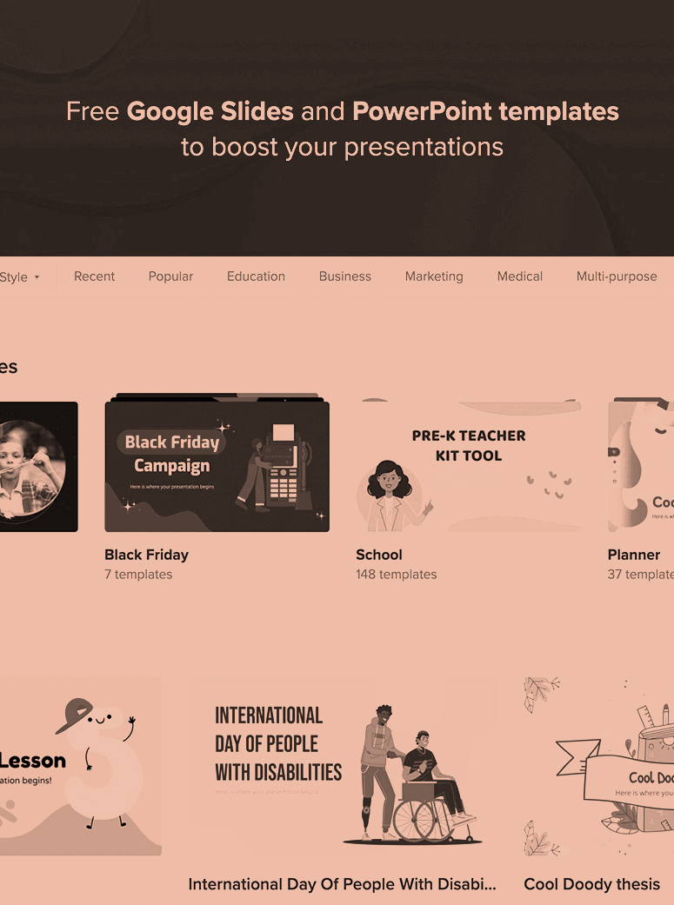
03 High-Technology
Japan is probably the best country to feel the coming of the future!

Slide 8

Japanese food is just as great as the country itself.
04 Food

Slide 9
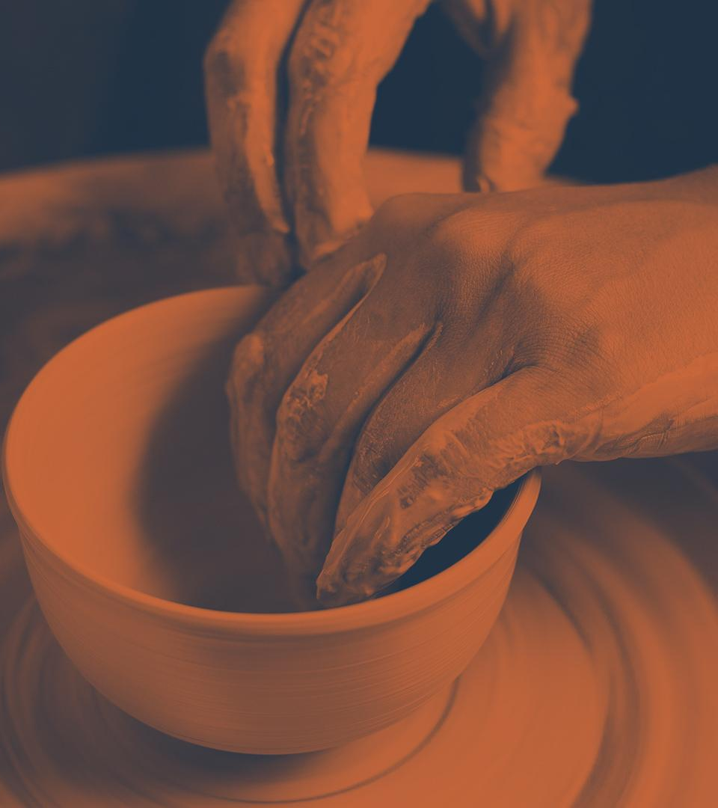
05 Culture!
Japan has developed different culture of futuristic and modern

Slide 10
Thanks
Do you have any questions?

